Slide 1
INTREN/PECO Project: Clay 343
Purpose:
To improve infrastructure performance to withstand storm impact.
Schedule:
Project will begin only after Township and PADOT Approvals have been granted.
Anticipated start date is March 6, 2023.
Anticipated finish date is April 24, 2023.
Scope:
Performed by INTREN for PECO.
Safety:
Lane and Road closures will be required to safely complete work.
Work schedule: 0800 to 1600, Monday through Friday.
Replace poles (24), cutouts, insulators, guys, and additional infrastructure.
Work location schedule will be provided weekly and daily to Township and Residents via Township Website, Facebook Page, and Emergency Services.

Slide 2
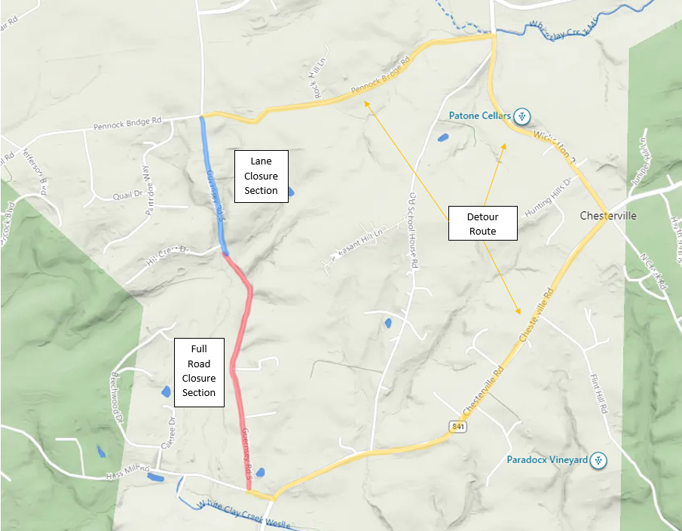
Proposed Detour Route

Slide 3
Notes about Lane & Road Closures
Lane Closure Section:
Guernsey Rd. from Pennock Bridge Rd. to just south of Hillcrest Dr.
The crew will be able to work in one lane without full road closure.
Public vehicles, buses, and mail delivery vehicles will be able to pass during this time.
Traffic Control will be in place to direct traffic during this lane closure.
Road Closure Section:
Guernsey Rd. from just south of Hillcrest Dr. to Hess Mill Rd.
Full road closure will be required for crews to safely complete work.
Traffic Control will be in place to ensure no traffic encroaches on this area.
Road will only be closed in section where work is being performed.
The crews will be able to lift jack stands on bucket trucks temporarily to allow for EMS, bus, and mail carrier passage.
Public Vehicles will be able to travel above or below the work location each day, but not in the section being worked at the time.
A schedule for work with section to be impacted will be shared daily.
Detailed signage for this road closure to be displayed at both ends of Guernsey Rd.
Sign templates will be sent to PECO and Franklin Township for approval prior to implementation.
INTREN is working to acquire space near this project to allow for equipment storage and minimize travel time to job location.
This will allow the crews to work from 0800 to 1600 daily.
Maintaining this schedule will shorten project duration.

